Slide 1
Arithmetic for Computers
§3.1 Introduction
Operations on integers
Addition and subtraction
Multiplication and division
Dealing with overflow
Floating-point real numbers
Representation and operations

Slide 2
Floating Point
§3.5 Floating Point
Representation for non-integral numbers
Including very small and very large numbers
Like scientific notation
–2.34 × 10⁵⁶
+0.002 × 10^{–4}
+987.02 × 10⁹
In binary
±1.xxxxxxx₂ × 2^{yyyy}
Types float and double in C
normalized
not normalized

Slide 3
Floating Point Standard
Defined by IEEE Std 754-1985
Developed in response to divergence of representations
Portability issues for scientific code
Now almost universally adopted
Two representations
Single precision (32-bit)
Double precision (64-bit)

Slide 4
IEEE Floating-Point Format
single: 8 bits double: 11 bits
single: 23 bits double: 52 bits
S
Exponent
Fraction
S: sign bit (0 ⇒ non-negative, 1 ⇒ negative)
Normalize significand: 1.0 ≤ |significand| < 2.0
Always has a leading pre-binary-point 1 bit, so no need to represent it explicitly (hidden bit)
Significand is Fraction with the “1.” restored
Exponent: excess representation: actual exponent + Bias
Ensures exponent is unsigned
Single: Bias = 127; Double: Bias = 1023

Slide 5
Single-Precision Range
Exponents 00000000 and 11111111 reserved
Smallest value
Exponent: 00000001 ⇒ actual exponent = 1 – 127 = –126
Fraction: 000…00 ⇒ significand = 1.0
±1.0 × 2^{–126} ≈ ±1.2 × 10^{–38}
Largest value
exponent: 11111110 ⇒ actual exponent = 254 – 127 = +127
Fraction: 111…11 ⇒ significand ≈ 2.0
±2.0 × 2⁺¹²⁷ ≈ ±3.4 × 10⁺³⁸

Slide 6
Double-Precision Range
Exponents 0000…00 and 1111…11 reserved
Smallest value
Exponent: 00000000001 ⇒ actual exponent = 1 – 1023 = –1022
Fraction: 000…00 ⇒ significand = 1.0
±1.0 × 2^{–1022} ≈ ±2.2 × 10^{–308}
Largest value
Exponent: 11111111110 ⇒ actual exponent = 2046 – 1023 = +1023
Fraction: 111…11 ⇒ significand ≈ 2.0
±2.0 × 2⁺¹⁰²³ ≈ ±1.8 × 10⁺³⁰⁸

Slide 7
Floating-Point Example
Represent –0.75
–0.75 = (–1)¹ × 1.1₂ × 2^{–1}
S = 1
Fraction = 1000…00₂
Exponent = –1 + Bias
Single: –1 + 127 = 126 = 01111110₂
Double: –1 + 1023 = 1022 = 01111111110₂
Single: 1011111101000…00
Double: 1011111111101000…00

Slide 8
Floating-Point Example
What number is represented by the single-precision float
11000000101000…00
S = 1
Fraction = 01000…00₂
Fxponent = 10000001₂ = 129
x = (–1)¹ × (1 + 01₂) × 2^{(129 – 127)}
= (–1) × 1.25 × 2²
= –5.0

Slide 9
Denormal Numbers
Exponent = 000...0 ⇒ hidden bit is 0
Smaller than normal numbers
allow for gradual underflow, with diminishing precision
Denormal with fraction = 000...0
Two representations of 0.0!

Slide 10
Infinities and NaNs
Exponent = 111...1, Fraction = 000...0
±Infinity
Can be used in subsequent calculations, avoiding need for overflow check
Exponent = 111...1, Fraction ≠ 000...0
Not-a-Number (NaN)
Indicates illegal or undefined result
e.g., 0.0 / 0.0
Can be used in subsequent calculations

Slide 11
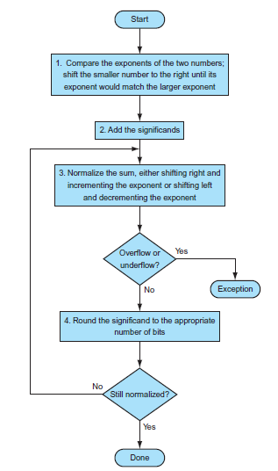
Floating-Point Addition

Slide 12
Floating-Point Addition
Consider a 4-digit decimal example
9.999 × 10¹ + 1.610 × 10^{–1}
1. Align decimal points
Shift number with smaller exponent
9.999 × 10¹ + 0.016 × 10¹
2. Add significands
9.999 × 10¹ + 0.016 × 10¹ = 10.015 × 10¹
3. Normalize result & check for over/underflow
1.0015 × 10²
4. Round and renormalize if necessary
1.002 × 10²

Slide 13
Floating-Point Addition
Now consider a 4-digit binary example
1.000₂ × 2^{–1} + –1.110₂ × 2^{–2} (0.5 + –0.4375)
1. Align binary points
Shift number with smaller exponent
1.000₂ × 2^{–1} + –0.111₂ × 2^{–1}
2. Add significands
1.000₂ × 2^{–1} + –0.111₂ × 2^{–1} = 0.001₂ × 2^{–1}
3. Normalize result & check for over/underflow
1.000₂ × 2^{–4}, with no over/underflow
4. Round and renormalize if necessary
1.000₂ × 2^{–4} (no change) = 0.0625

Slide 14
FP Adder Hardware
Much more complex than integer adder
Doing it in one clock cycle would take too long
Much longer than integer operations
Slower clock would penalize all instructions
FP adder usually takes several cycles
Can be pipelined

